Slide 1

Data-Driven control modelling of a two wheeled self balancing robot
Course Project for CS637A (Embedded and CyberPhysical Systems) Team: Akshat Arya, Batta Soumith, Naveen Teja

Slide 2
Problem Identification
Last Mile Delivery
In delivery, especially in “last mile” parcel delivery, there are very many factual problems that make this section of the delivery process expensive and inefficient due to dependence on manpower. However, as the parcel delivery market is swept along by the tremendous growth of online commerce, high hopes are being pinned on technological solutions to the “last mile” problem.
Above all, robotics and, to be precise, autonomous robotics are considered forward-looking. This means the delivery of parcels (and also food or similar) by means of small mobile vehicles (“delivery robots”) or delivery drones.

Slide 3
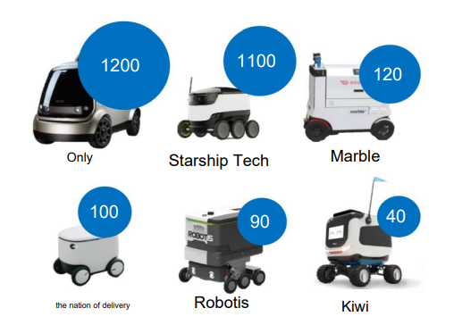
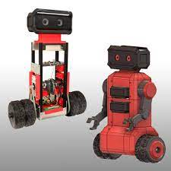
Existing Solutions

Slide 4
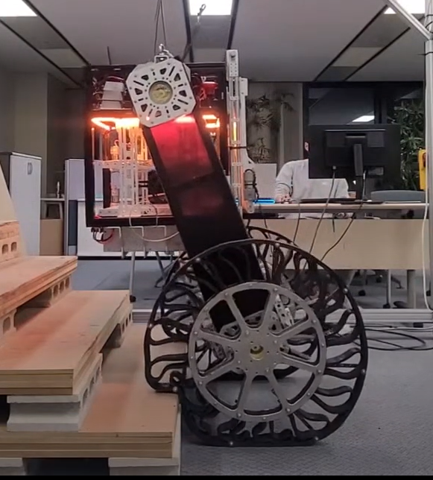
01.
Two Wheel Delivery Robot
Modelling

Slide 5
DEVELOPMENT STAGES
Structure and Dynamics
CAD Modelling
Manufacture and Assembly
Designed various models in Fusion 360 suitable to our requirement
Deciding the dimensions. Choice of Motors and drivers Battery pack Reduction techniques
Material acquisition
Solving manufacturing problems
Deciding the respective components available in market

Slide 6
Structure and Dynamics
Structure
Dynamics
Material chosen: Aluminium Extrusion Actuator: Nema 23 (18 kgf) Motor driver:TB6600
Dimensions: cage:30x30x30cm frame:50x10cm
3 models were thought of based on the dynamics requires to rotate the cage

Slide 7
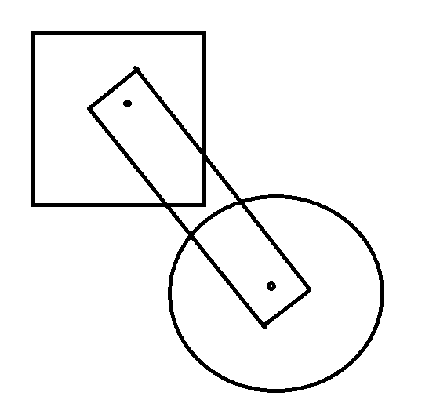

Slide 8
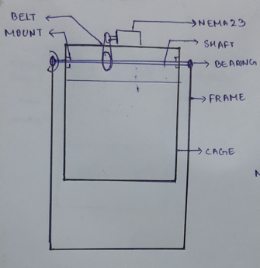

Slide 9
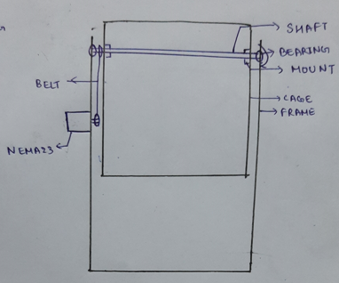

Slide 10
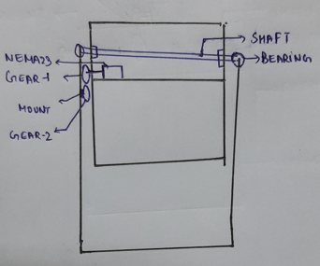

Slide 11

CAD Modelling
We tried modelling our imagination into Computer-Aided-design(CAD)
Modelling of structure
Modelling of tweels(non pneumatics tubeless tyres)

Slide 12
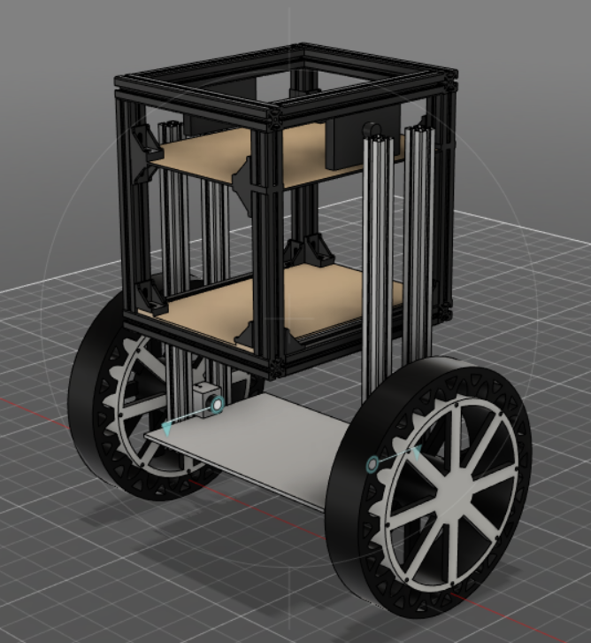
Components Required
Sensors:MPU6050x3
Nema23 TB6600 Mounts and bearing Lipo battery(5500mAh 24V) Arduino Uno
Level-1
Level-2
Area to keep payload
Nema23x2 TB6600x2 Mounts and bearing
Arduino UNO Raspberry pi-3B
Level-3

Slide 13
Problems faced
Tweels
Stepper Motor
Power Supply
Aluminium Exrtusions
Mechanical knowledge
Budget
Designing of tweels and its alternative
Controlling a stepper with the accelstepper library
Providing the accurate power supply
FInding connectors for extrusions
We required a budget of 20k to complete this project

Slide 14
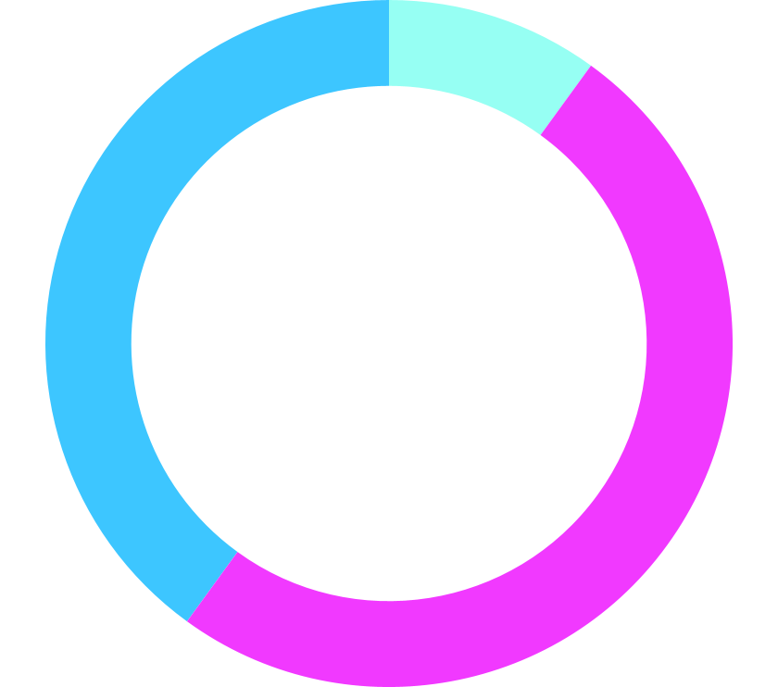
How did we finally build the robot?
10%
Buying Materials
40%
Manufacturing and Assembly
50%
Jugaad
A lot time went in roaming in streets of LaTouche road and hardware shops.
Cutting, drilling and joining all the components.
Replacing unavailable parts with unconventional alternatives.

Slide 15
Current updates
We have arranged all the required components.
Using buggy wheels as an alternative to tweels
Trying to complete the assembly of our robot

Slide 16
Future Plans and timeline
10%
Data Acquisition
40%
Cleaning Data
50%
Training the model in Open AI-Gym
Once we are done with assembly. We will be start acquiring input and output data points
Go through the recorded data and remove all the human errors and errors while recording data
We will train a controller for this non-linear system using RL on Gym platform

Slide 17
Work distribution:
Names: | Work done:
Batta Soumith | Work done equally
Akshat Arya | Work done equally
B Naveen Teja | Work done equally

Slide 18
THANKS
Do you have any questions?
LMiT-22 has the capability to solve the last mile delivery problems, our world is currently facing

